Slide 1



Slide 2
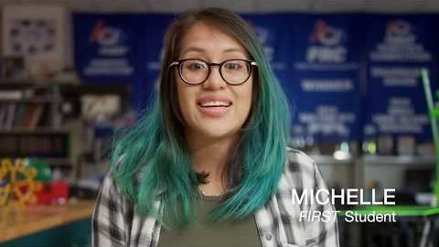

Slide 3

Lincoln High School
Tigers 5540
FRC

Slide 4
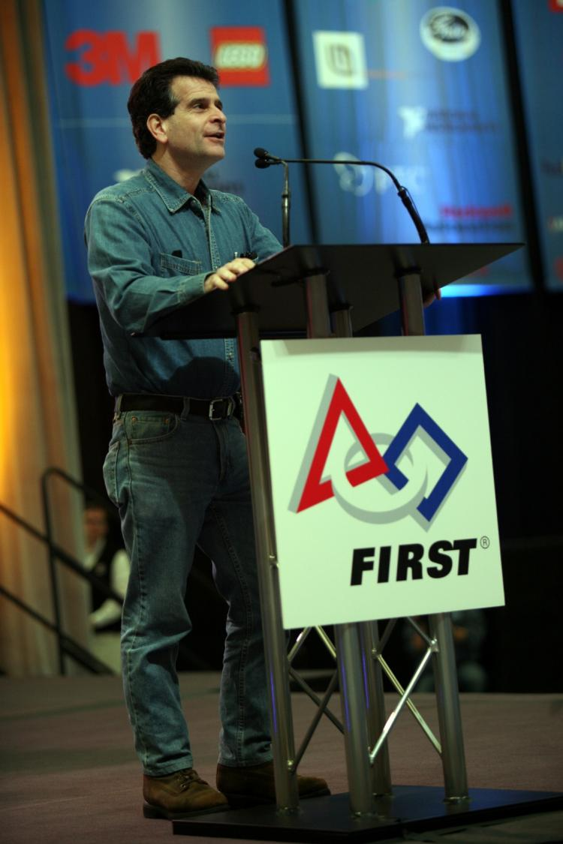

For Inspiration and Recognition of Science and Technology
1989
4
Founded
Divisions
350k
32k
Students
Teams
29k
Robots
66k
64k
Founder: Dean Kamen
Volunteers
Mentors
Notes:
Founded 1989
2013:
25,000 robots built
314,000 students
126,000 Volunteers
$16 million scholarships
50 States, 70 contries

Slide 5


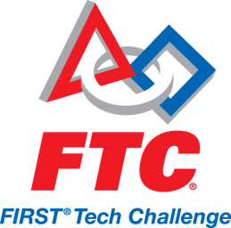

The FIRST Continuum
K-3
Grade 4-8
Grade 7-12
Grade 9-12

Slide 6

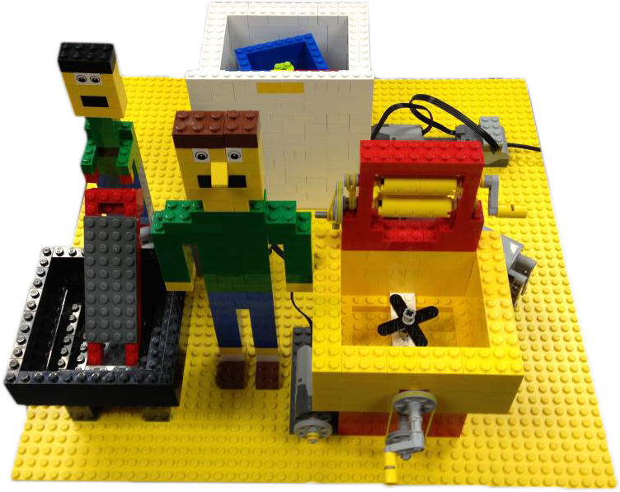


Grades
Age
Teams
Team Size
Mentors
Students
Season
Countries
Budget
k-3
6-9
3,347
2-6
1-3
20,000
Aug - April
12
$50-$200
Notes:
Grade k-3
Students: 20,000
2012: Teams 3,347
100 regional events

Slide 7
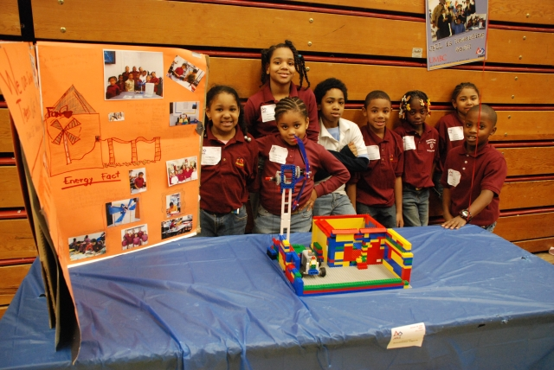

Slide 8

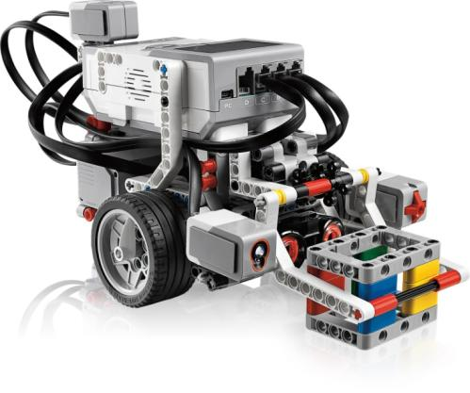
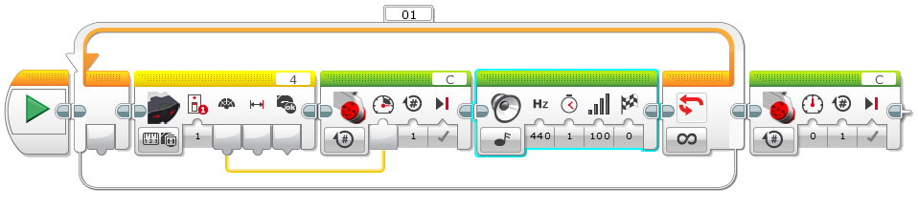
FIRST LEGO League
Grades
Age
Teams
Team Size
Mentors
Students
Season
Countries
Robot
Software
Budget
Field
4-8
9-14
20,430
2-10
2 per team
204,000
Aug-April
70
MINDSTORMS
LEGO EV3/NXT-G
$300-$1000
4’x8’Table
Notes:
Grades 4-8
Age 9-14
2012 Teams: 20,430
Students: 204,000
70 countries

Slide 9
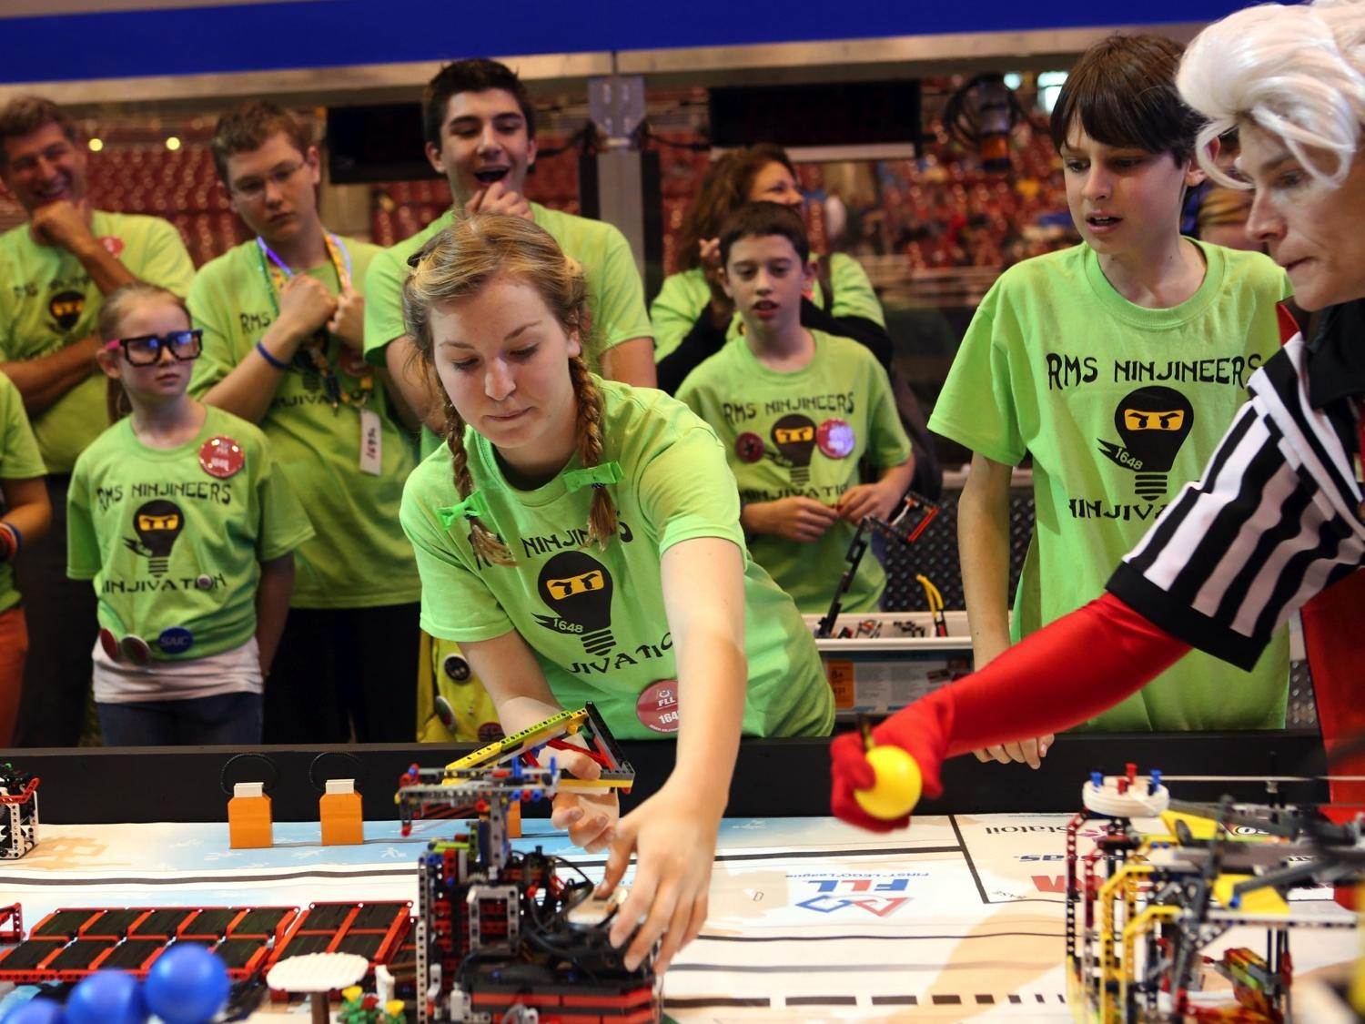
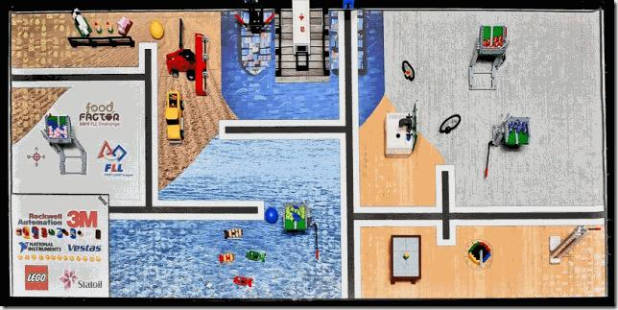
Notes:
*auto-builds and transitions*
DO NOT CLICK
Students competing in FIRST Lego League

Slide 10

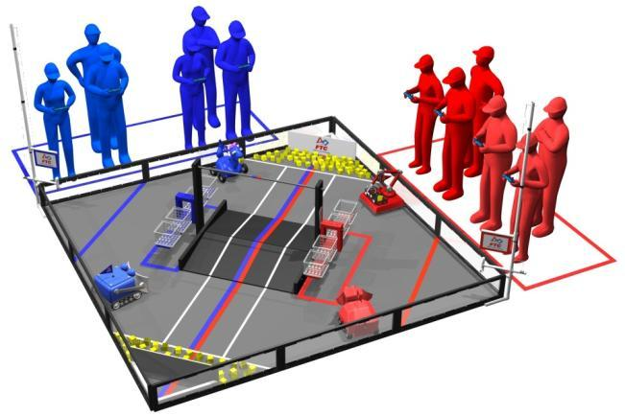
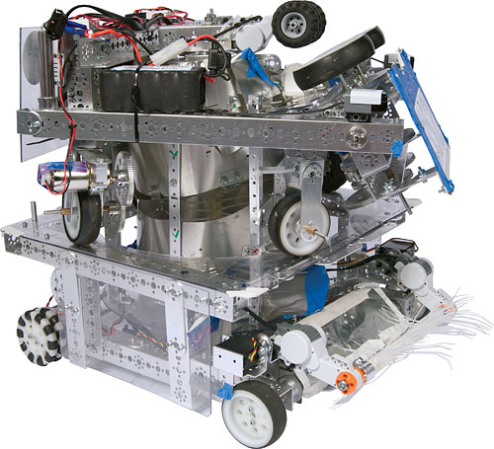
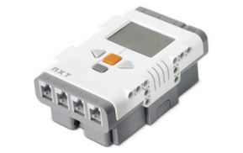
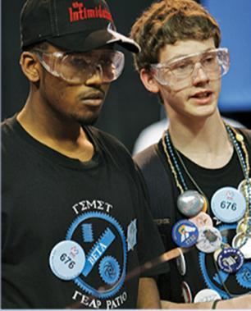
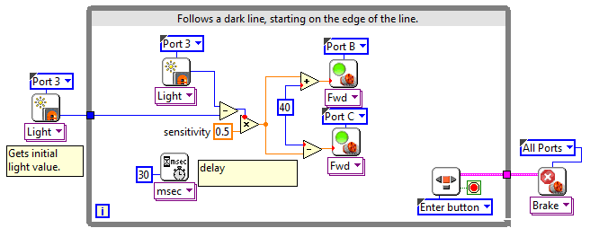
Grades
Age
Teams
Team Size
Mentors
Students
Season
Countries
Robot
Software
Budget
Field
7-12
12-18
2,779
~10
2-3 per team
27,000
Sept - April
18
NXT + TETRIX/MATRIX
LabVIEW / RobotC
$1,200 - $4000
12’ x 12’ Field
Notes:
Grades 7-12
18 countries
Participants 27,000
2012 Teams: 2,779

Slide 11
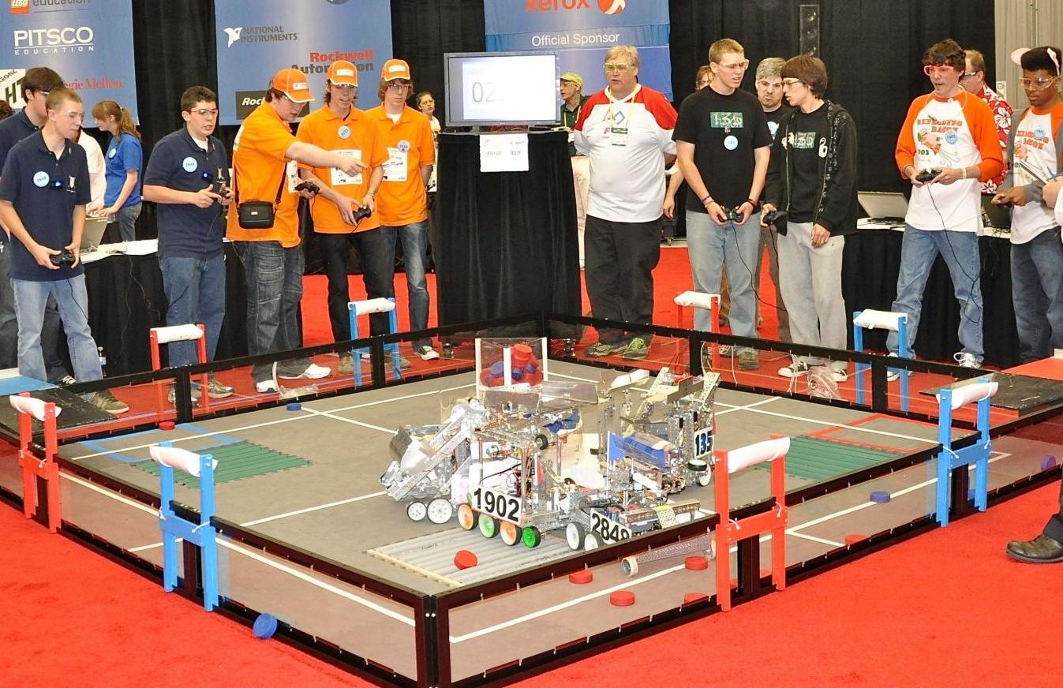

Slide 12

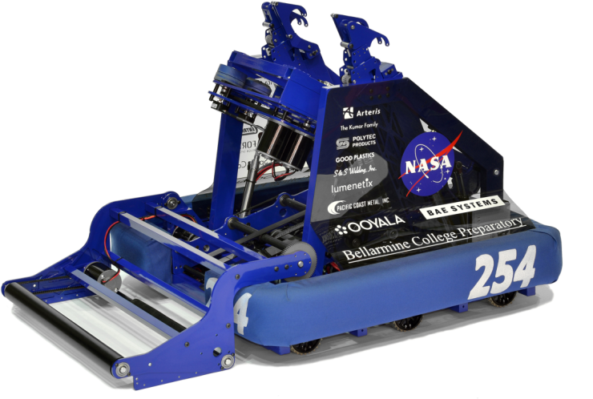
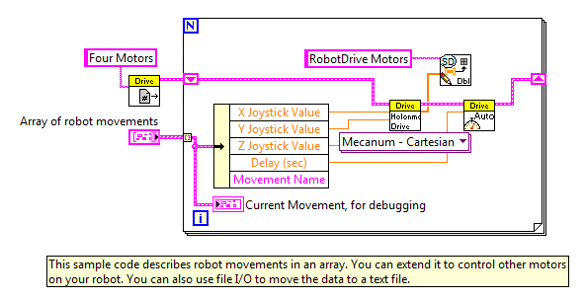
FIRST Robotics Competition
Grades
Age
Teams
Team Size
Mentors
Students
Season
Countries
Robot
Software
Budget
Field
9-12
14-18
2,546
10-25
2-10 per team
63,000
Jan - April
17
NI roboRIO
LabVIEW / C / Java
$5000-$7000
24’x 58’ Arena
Notes:
Grades 9-12
Students: 63,000
2013 Teams: 2,546
17 countries

Slide 13
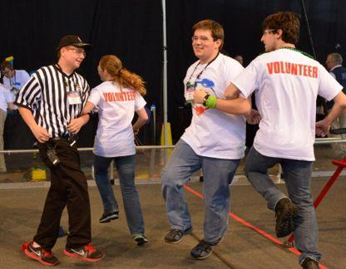
Get Involved: Volunteer
Hour / Week
Weeks / Year
Roles
2-10
1-20
judge
referee
robot inspector
timer
score keeper
MC
check-in
snack coordinator
photographer

Slide 14
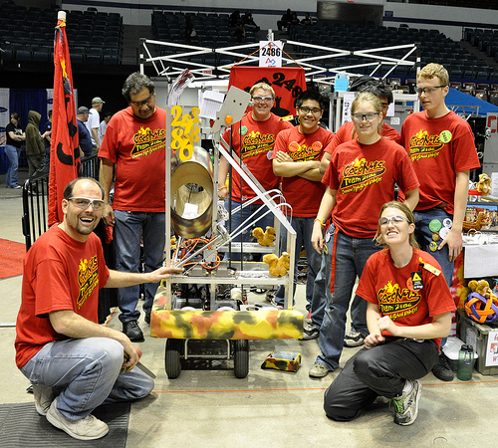
Get Involved: Coach / Mentor
Hour / Week
Weeks / Year
Skills
2-20
6-20
construction fabrication
programming
multimedia
CAD
leadership
logistics

Slide 15

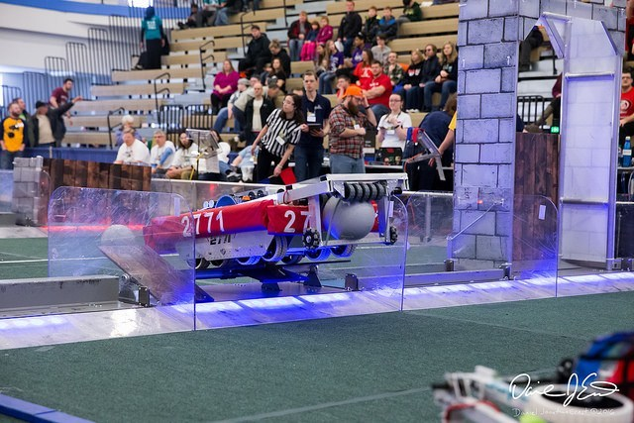
2016

Slide 16

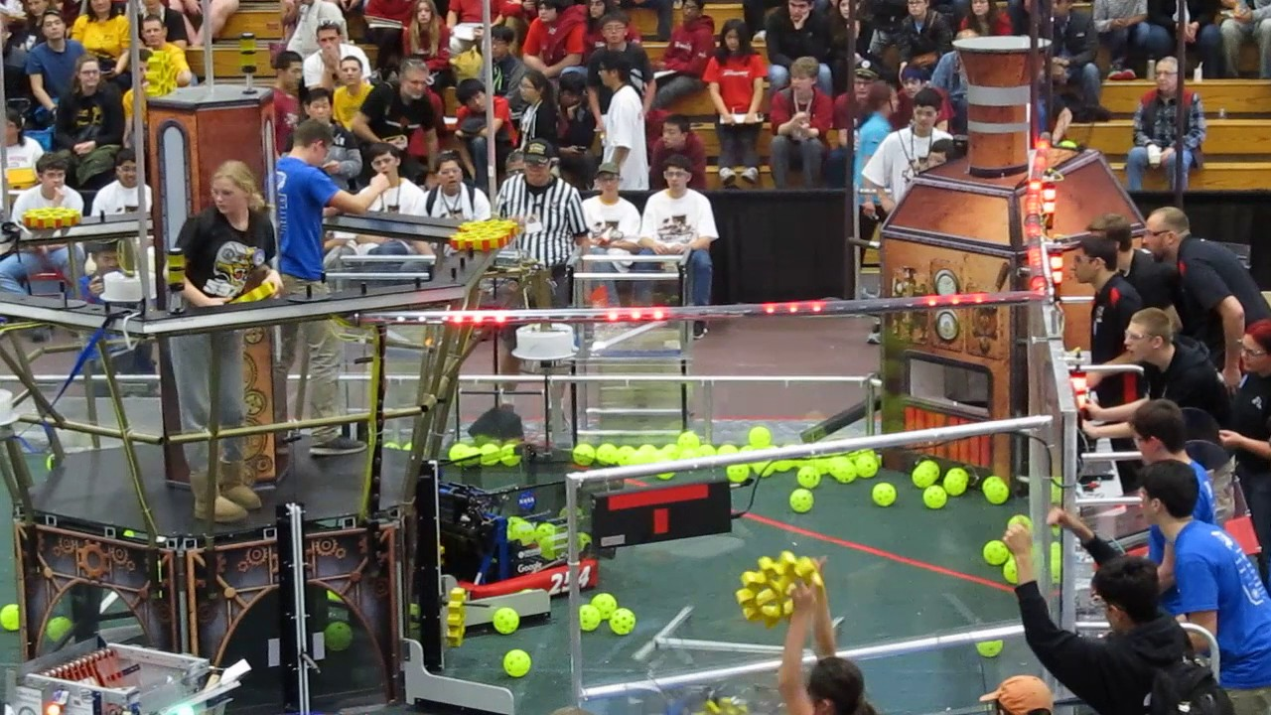
2017

Slide 17

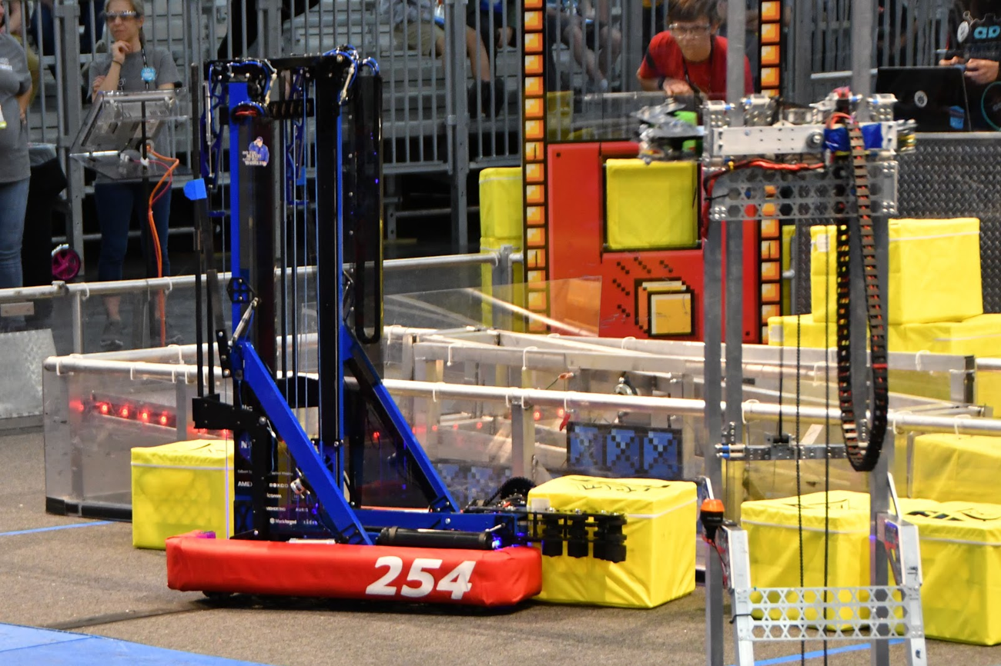
2018

Slide 18

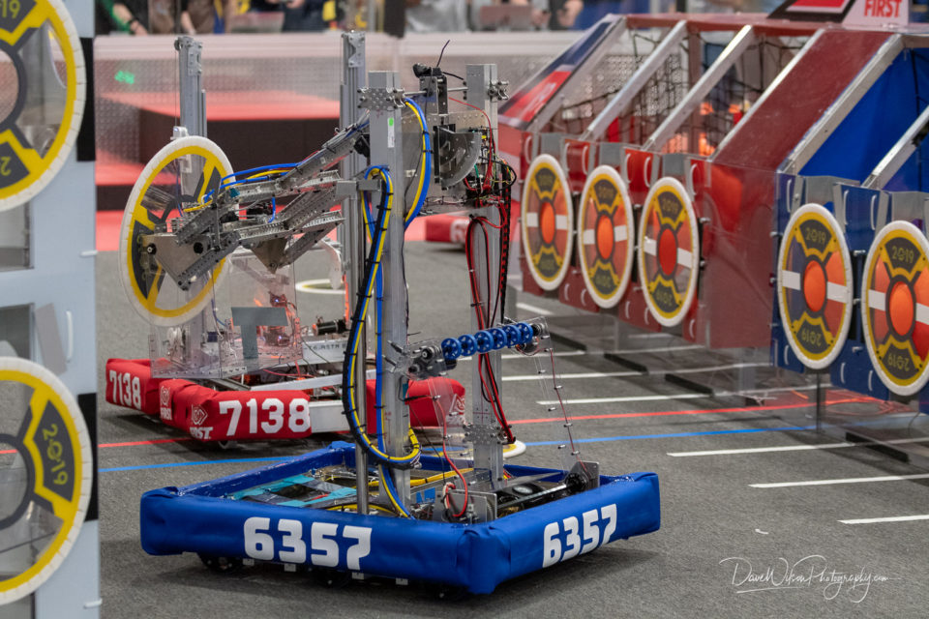
2019

Slide 19
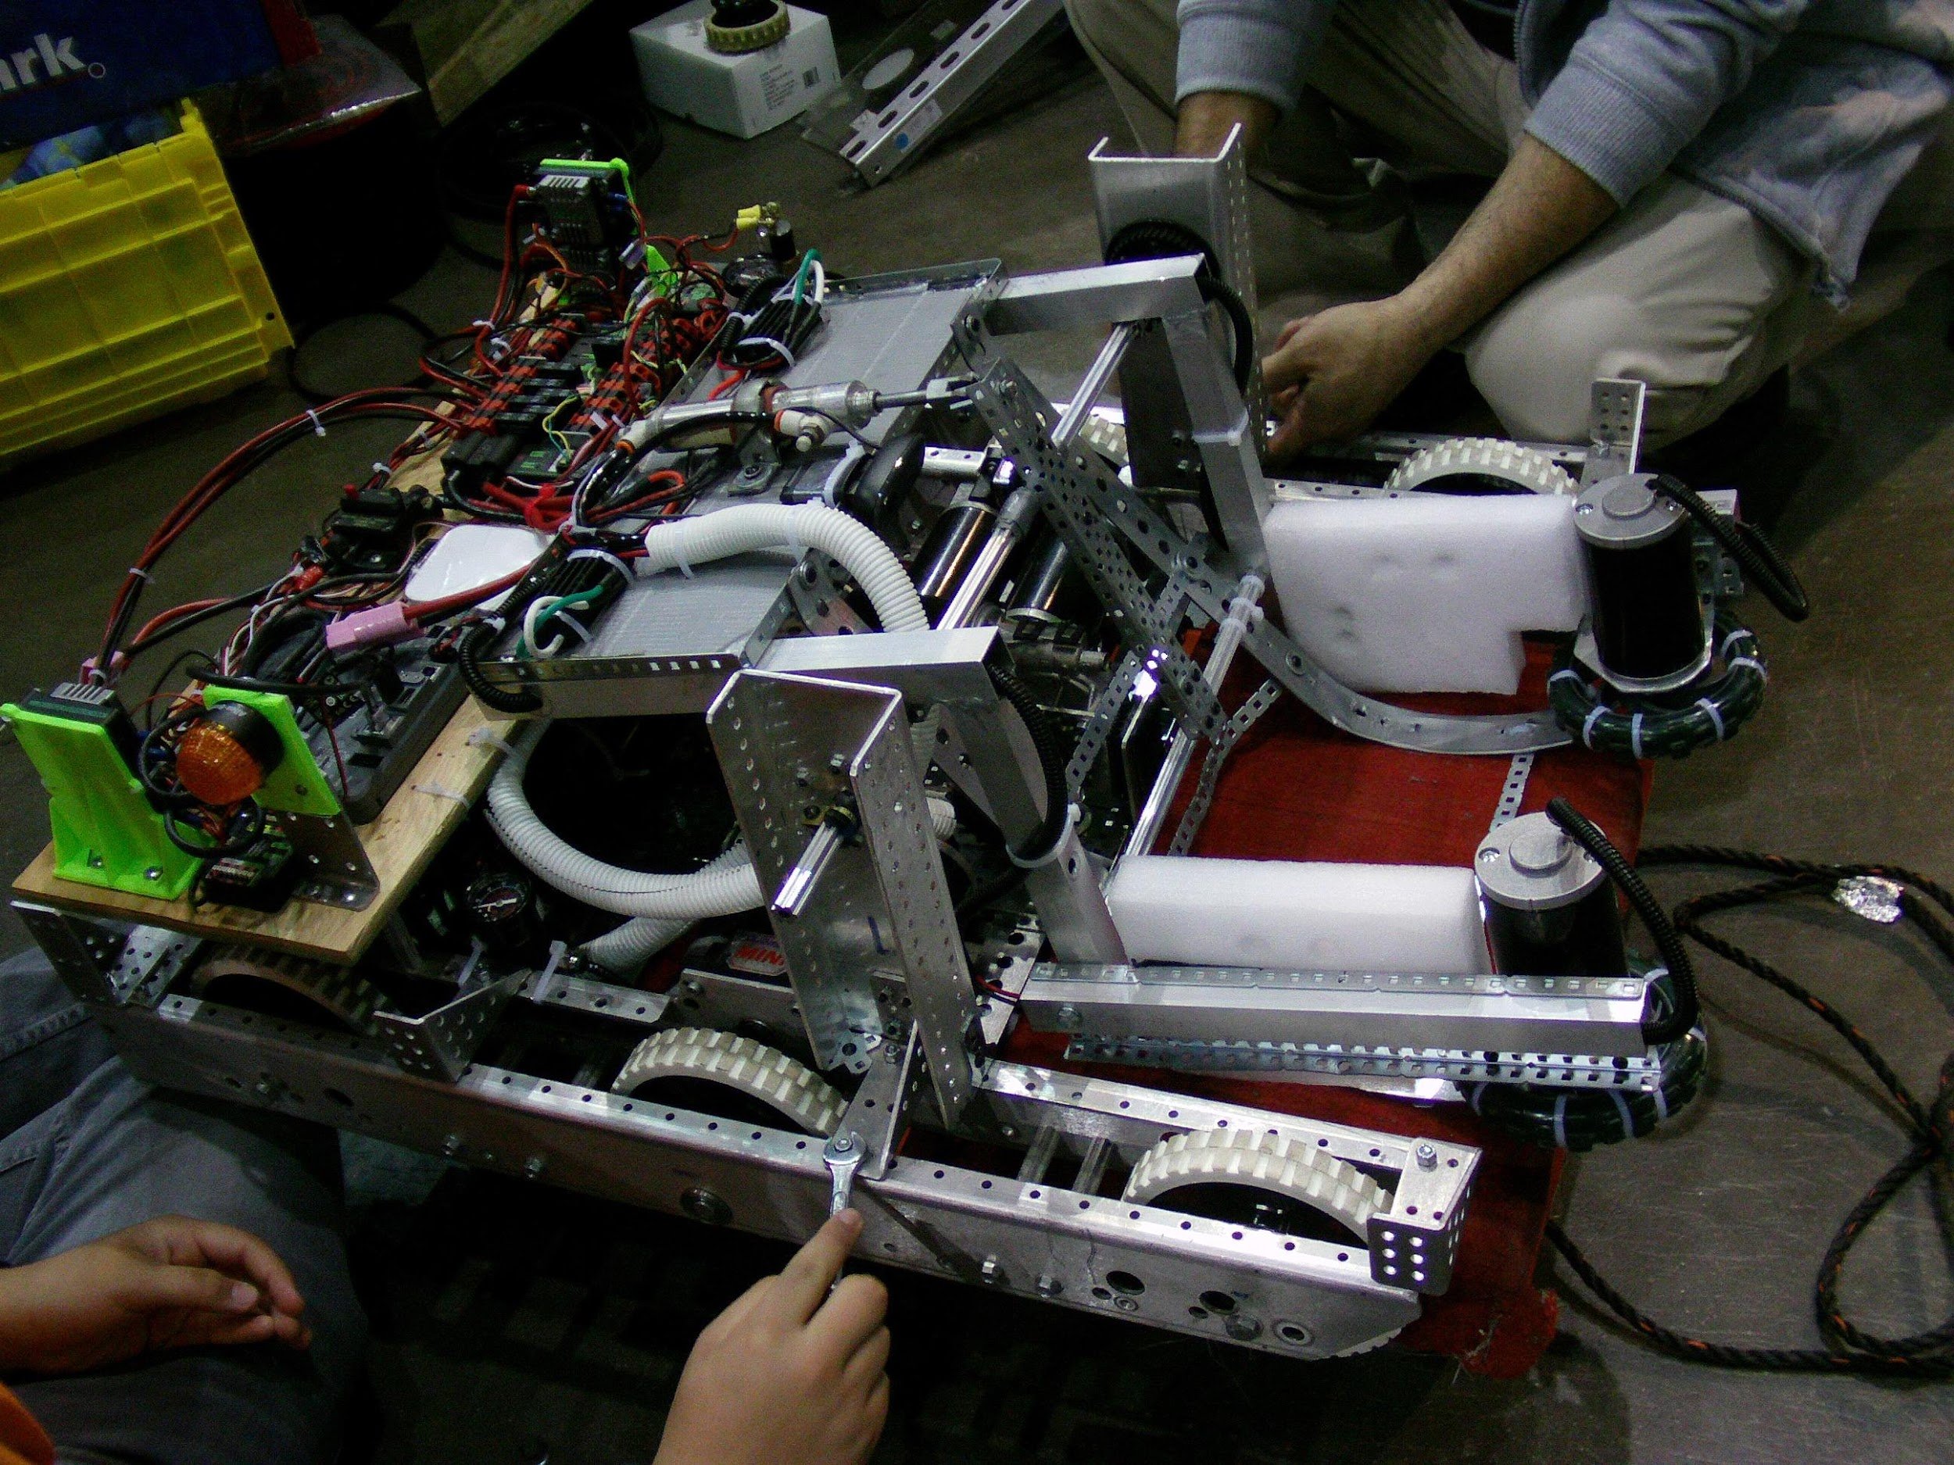

Slide 20
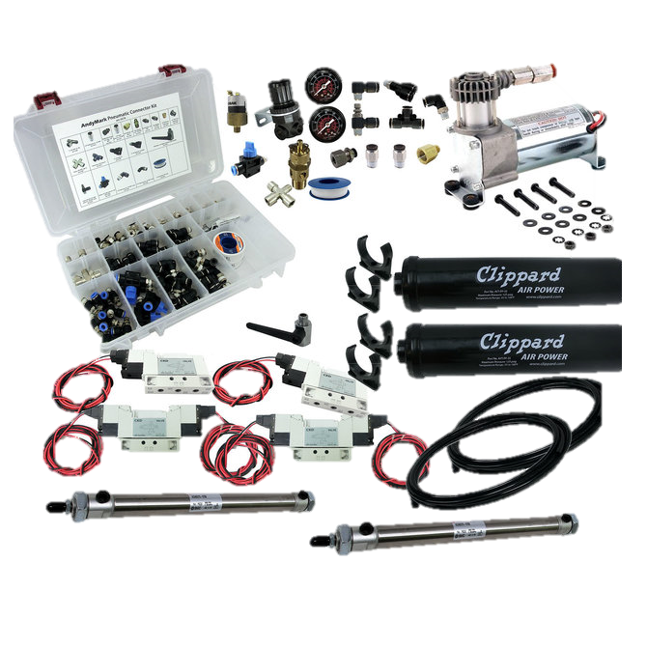
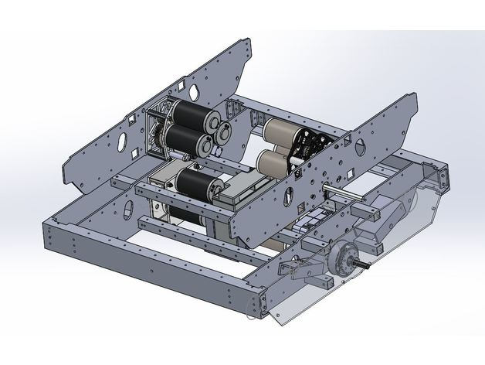
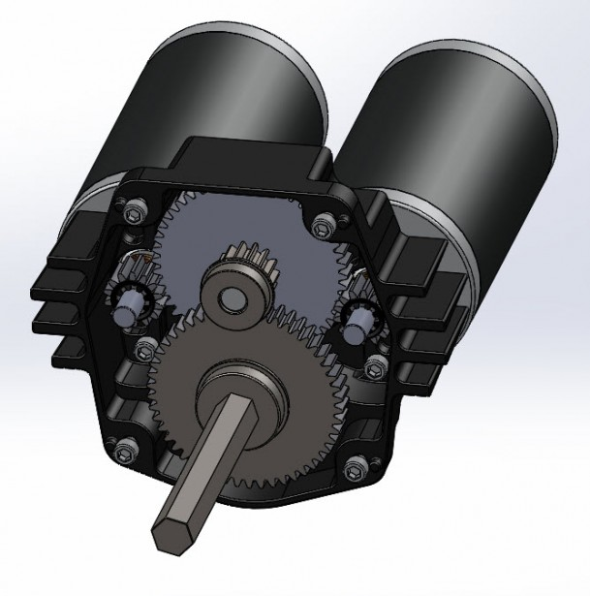

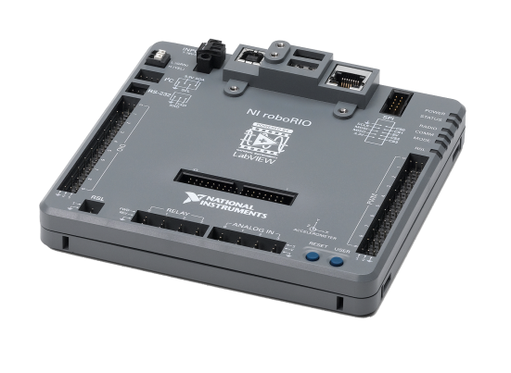
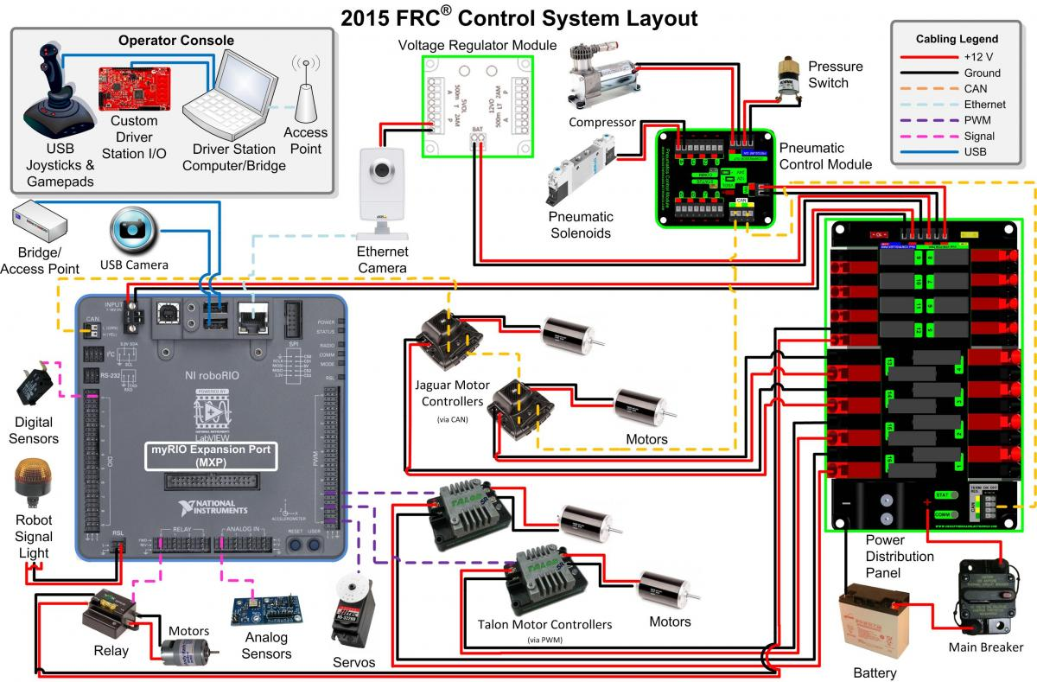
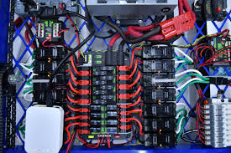

Slide 21


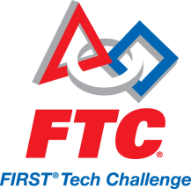

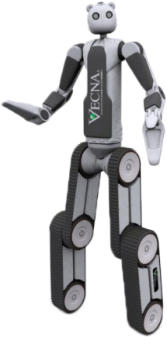

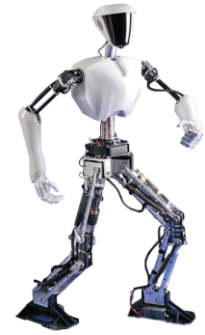
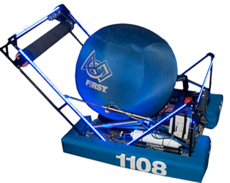
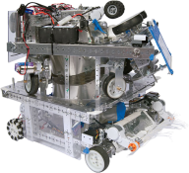
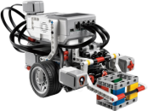

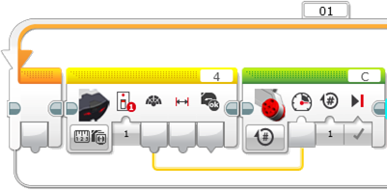
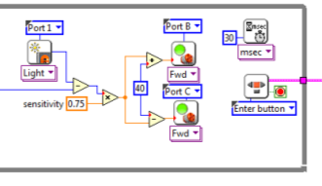
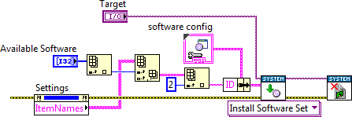
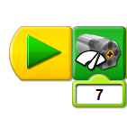
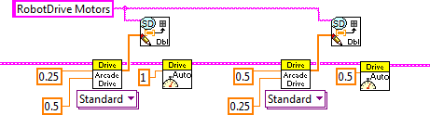
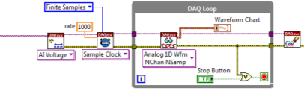
The LabVIEW Continuum
Career
Universities
Grade 9-12
Grade 7-12
Grade 4-8
K-3
WeDo
NXT-G, EV3
LVLM
LabVIEW

Slide 22

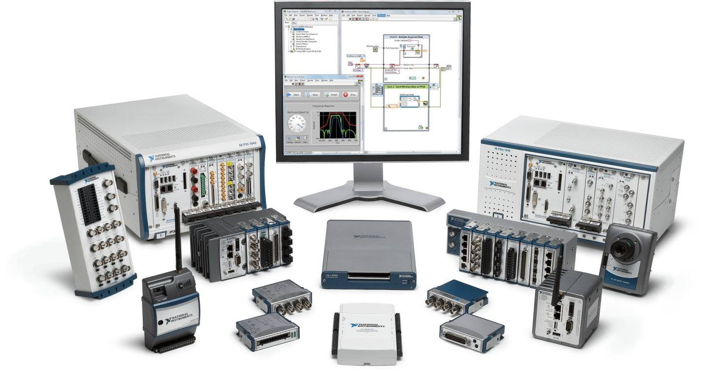
NI Products
Notes:
National Instruments makes a wide variety of hardware and software products for engineers and scientists.

Slide 23
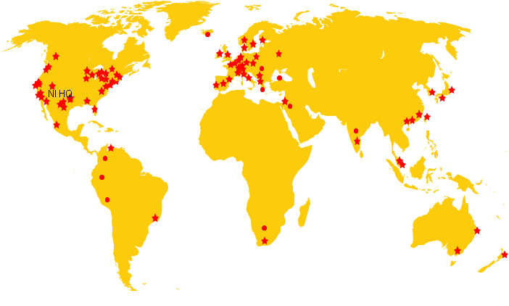

















































LabVIEW Adoption in Education
110
Countries
7000+
Universities

Slide 24
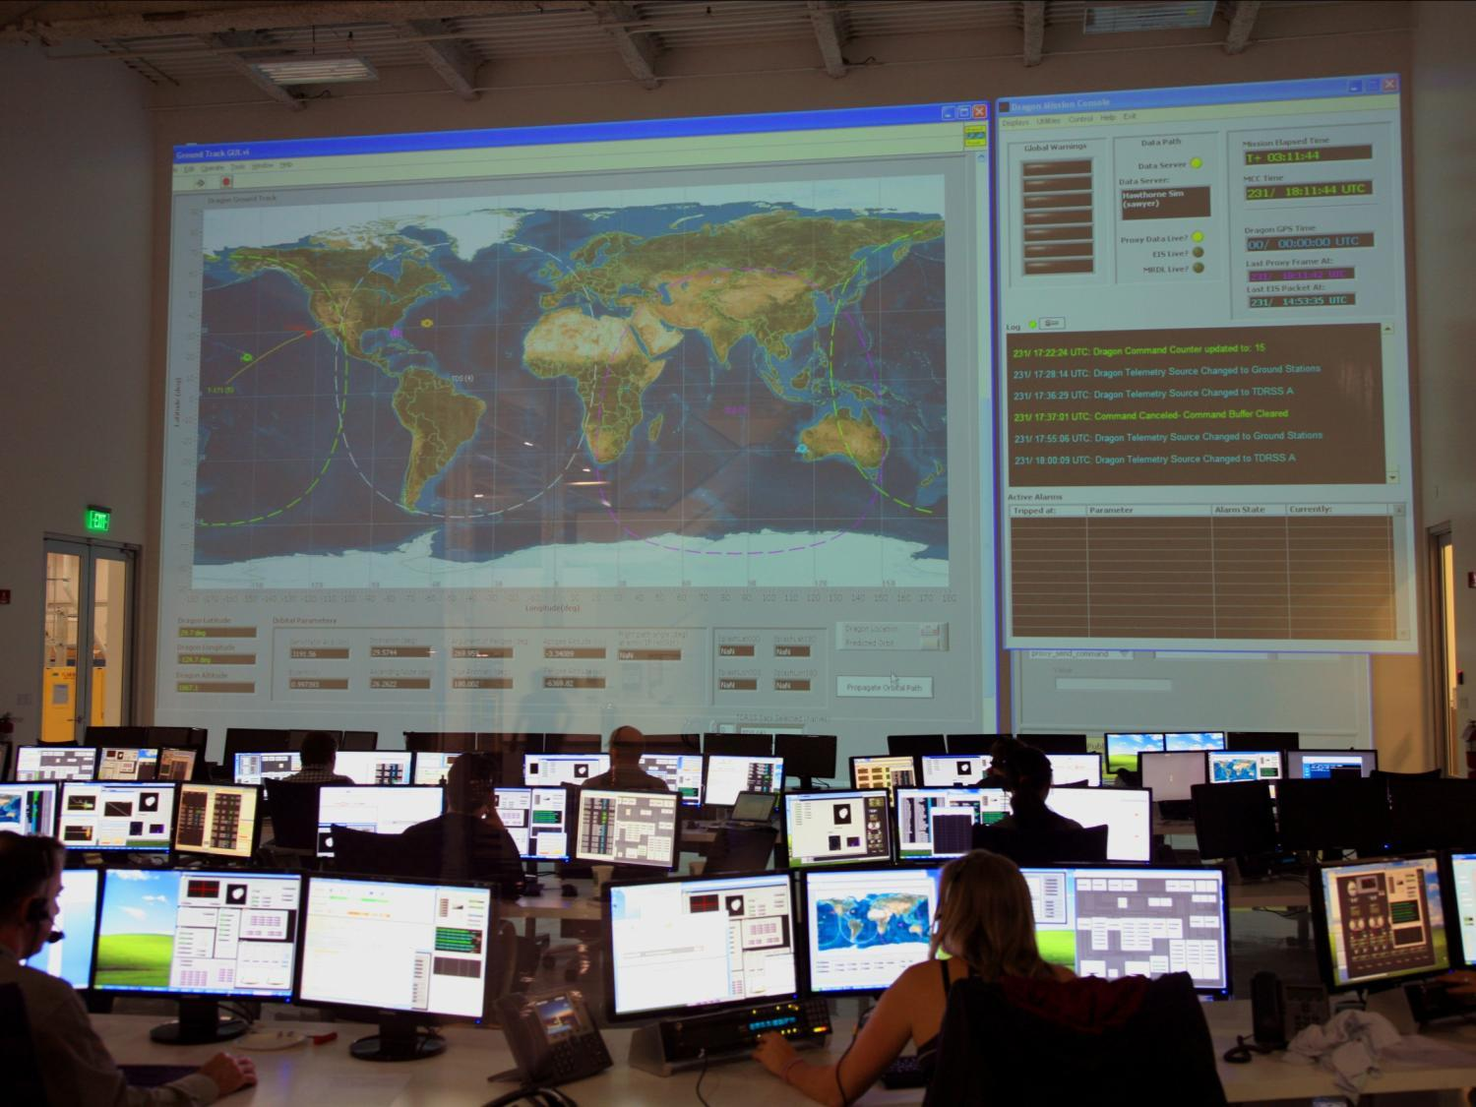


Notes:
Exploring Outer Space – but really, LabVIEW powers SpaceX mission control.

Slide 25


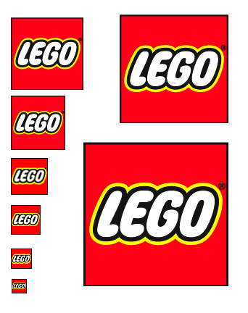


















Get Involved: Sponsor
Commitment
Sponsorships
$100 – $100k
teams
events
competitions
equipment
materials
transportation
media

Slide 26
Notes:
On top of the great student design and research projects, over 35,000 companies around the world leverage our technology to solve todays engineering grand challenges.
Through our hardware and graphical software integration (Graphical System Design), we accelerate the productivity, innovation, and discovery of engineers and scientists all over the world.

Slide 27
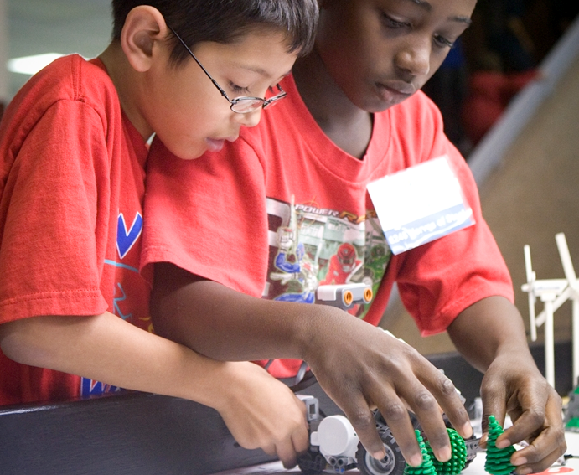
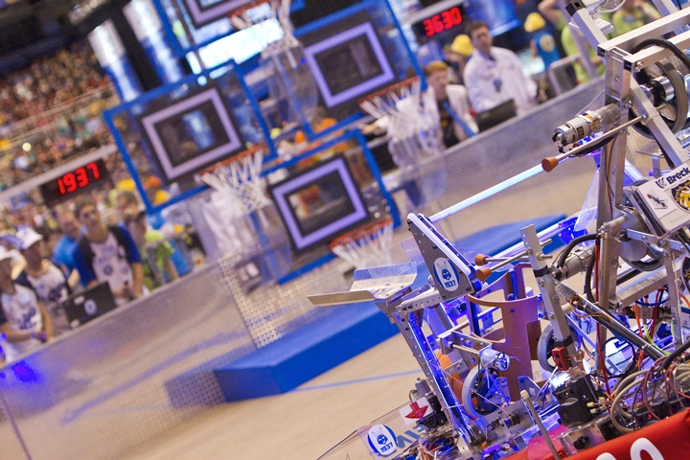

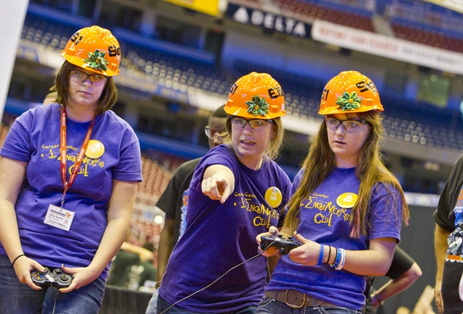
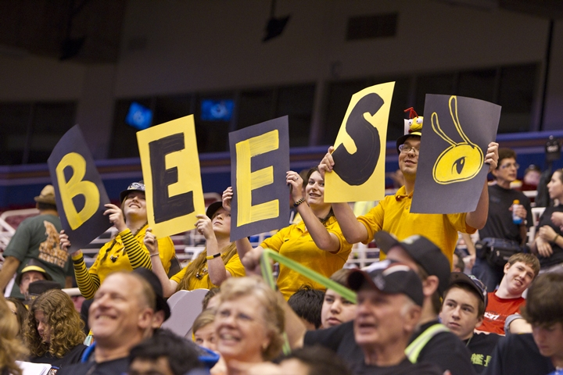
ni.com/first
usfirst.org
Notes:
Robotics clubs are a great start to inspiring the next generation. In 2012, 270,000 students used LabVIEW to program in robotics programs like FIRST worldwide.
NI powers student robotics competitions to make engineering as cool for kids as sports are today.
These competitions teach core engineering concepts, problem-solving skills, and leadership principles, and are linked directly to growing the number of students who pursue careers in engineering and science.
FIRST Robotics is devoted to helping young people discover and develop a passion for technology and engineering through robotics.
80% of team members reported that as a result of FIRST they wanted to learn about science and technology, were more interested in STEM careers and wanted to become an engineer or scientist
90% reported that they learned critical life and workplace skills through the program.
99% of FIRST alumni graduated high school. FIRST alumni are also substantially more likely to major in engineering than the average college student nationally.

Slide 28


